Slide 1
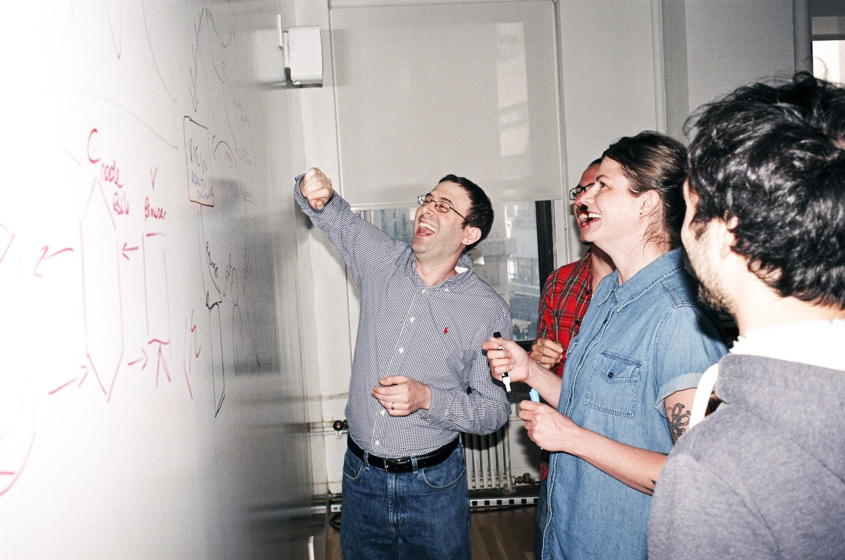

Welcome to General Assembly
WiFi GA Guest
Password yellowpencil
Notes:
[Leave this slide visible until presentation starts]

Slide 2

DATA SCIENCE
DAT11SYD
Lesson 15: Real World Data Science Skills
-Part1 - Cloud Computing -Part2 - “Soft Skills”

Slide 3
Course Plan
Final Countdown!

Slide 4
Lesson 15 - Review
FINAL PROJECT
- Final Project split into 4-parts: [Review with James 5mins]
(a) Real-world Problem Identification [Lesson 14]
(b) Data Cleaning [Lesson 15]
(c) Model & Validation [Lesson 16]
(d) Presentation & Storytelling [Lesson 17]
Lesson 18 – any final queries
Lesson 19 & 20 – Presenting final project back to class

Slide 5
Git & GitHub – 1 Pager Guide!

Slide 6
AGENDA
Part 1 – Big Data & Cloud Computing
Real World Data Science .vs. Data Science Course
Big Data Environments
NO LAB TODAY (Homework! ☺ )
--- TEA BREAK! ---
Part 2 - Soft Skills
Challenges working in a team (technical & non-technical)
Pitching projects to varied audiences
Relationship Management
Job hunting & Interviewing

Slide 7
PART 1
DATA SCIENCE PART TIME COURSE

Slide 8
Real World Data Science
BIG DATA! (GB, TB, PB!)
Data must be extracted & treated (SuperComputer “Cluster”) - SQL
Login via command-line or browser (rather than local)
Model is complex & consume lots of resource (SuperComputer “Cluster”)
Data Sampling may be required
Big Data Jobs must be submitted to a QUEUE
Separate DEVELOPMENT, VALIDATION (testing) and PRODUCTION
Data Science Project Management
Requirements gathering & Project Planning
Data discovery → Model Development → Implementation → Monitoring
Sales

Slide 9
Real World Data Science .vs. DAT11 course
BIG DATA! (GB, TB, PB!)
Data must be extracted & treated (SuperComputer “Cluster”) - SQL
Login via command-line or browser (rather than local)
Model is complex & consume lots of resource (SuperComputer “Cluster”)
Data Sampling may be required
Big Data Jobs must be submitted to a QUEUE
Separate DEVELOPMENT, VALIDATION (testing) and PRODUCTION
Data Science Project Management
Requirements gathering & Project Planning
Data discovery → Model Development → Implementation → Monitoring
Sales
Final Project

Slide 10
BIG DATA & CLOUD COMPUTING
DATA SCIENCE PART TIME COURSE

Slide 11
Initial Big Data setup (simplified)
Purchase a supercomputer (a “cluster”) with LOTS of power
Purchase LOTS of disk space to connect to the supercomputer
Implement a “Data Lake” framework
Bespoke Code
(slow, hard)
Data Lake
(pretty much any format you can think of – but mostly text files)

Slide 12
Hadoop Distributed File System (“HDFS” / “Hadoop”)
This is also simplified (but you get the idea!)
Hadoop “Map-Reduce”
Data of the relevant type is mapped by mappers (most of the slaves) (e.g. sorting coins of the same type into 20c, $1, $2 etc)
Sorted Data is then collected by the “Reducers” (a few of the slaves) and aggregated as required: (e.g. 20 x $2 → $40, 50 x $1 → $50, 400 x 20c → $80)
Typically done using Java
Master Nodes
Master Nodes
Data Lake
Master Nodes
Master Nodes
Slave Nodes

Slide 13
HDFS & MapReduce using Hive
Java = quite specialised in 2010+
Most people in business know SQL…
HIVE = Layer over the top of Hadoop → Hive SQL (“HQL”)
Resource Manager
Hive SQL
(HQL)
Java (Map-Reduce)
Data Lake

Slide 14
Map-Reduce: Pseudo-Code Example from WikiPedia

Slide 15




WHAT IS IT AND WHY USE IT? (GOOGLE)
Compute Engine
Cloud SQL
Container Engine
BigQuery

Slide 16




WHAT IS IT AND WHY USE IT? (AWS)
EC2
RDS
Container Service
Redshift

Slide 17

WHY USE IT?

Slide 18
SPARK
DATA SCIENCE PART TIME COURSE

Slide 19
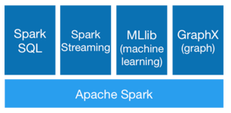
SPARK - WHAT IS IT?
Spark is a fast and general processing engine compatible with Hadoop data. It can process data in HDFS, HBase, Cassandra, Hive, and any Hadoop InputFormat. It is designed to perform both batch processing (similar to MapReduce) and new workloads like streaming, interactive queries, and machine learning.

Slide 20
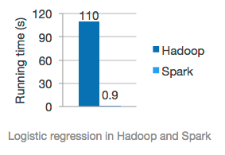
SPARK - HOW DOES IT RELATE TO DATA SCIENCE?
MLlib is Spark’s machine learning library. Its goal is to make practical machine learning scalable and easy. It consists of common learning algorithms and utilities, including classification, regression, clustering, collaborative filtering, dimensionality reduction, as well as lower-level optimization primitives and higher-level pipeline APIs.
GraphX in Spark for graphs and graph-parallel computation

Slide 21

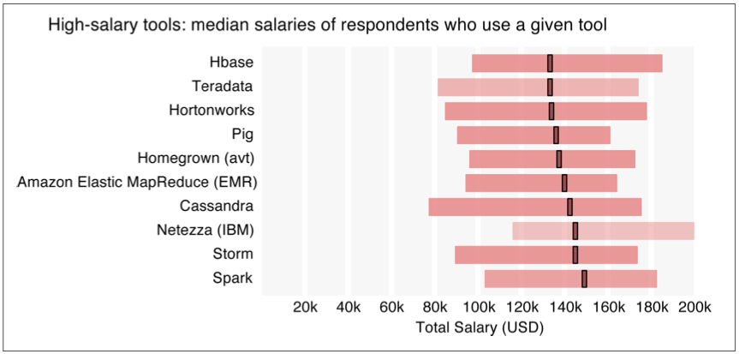
‘We can talk, but money talks, so talk more bucks’ - Jay-Z (Izzo - The Blueprint)

Slide 22
SPARK SQL
One use of Spark SQL is to execute SQL queries written using either a basic SQL syntax or HiveQL. Spark SQL can also be used to read data from an existing Hive installation.
Spark SQL provide Spark with more information about the structure of both the data and the computation being performed. Internally, Spark SQL uses this extra information to perform extra optimizations. There are several ways to interact with Spark SQL including SQL, the DataFrames API and the Datasets API. When computing a result the same execution engine is used, independent of which API/language you are using to express the computation.

Slide 23
SPARK DATAFRAMES
A DataFrame is a distributed collection of data organized into named columns.
It is conceptually equivalent to a table in a relational database or a data frame in R/Python, but with richer optimizations under the hood.
DataFrames can be constructed from a wide array of sources such as: structured data files, tables in Hive, external databases, or existing RDDs.

Slide 24
SPARK MLLIB
Data types
Basic statistics
summary statistics
correlations
stratified sampling
hypothesis testing
streaming significance testing
random data generation
Classification and regression
linear models (SVMs, logistic regression, linear regression)
naive Bayes
decision trees
ensembles of trees (Random Forests and Gradient-Boosted Trees)
isotonic regression
Collaborative filtering
alternating least squares (ALS)
Clustering
k-means
Gaussian mixture
power iteration clustering (PIC)
latent Dirichlet allocation (LDA)
bisecting k-means
streaming k-means
Dimensionality reduction
singular value decomposition (SVD)
principal component analysis (PCA)
Feature extraction and transformation
Frequent pattern mining
FP-growth
association rules
PrefixSpan
Evaluation metrics
PMML model export
Optimization (developer)

Slide 25
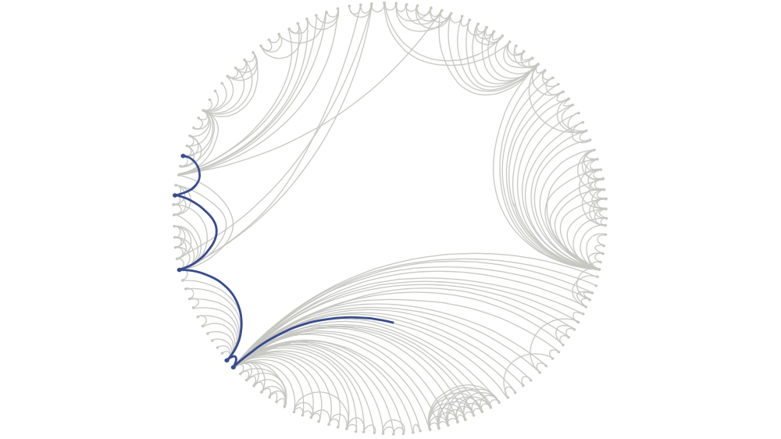
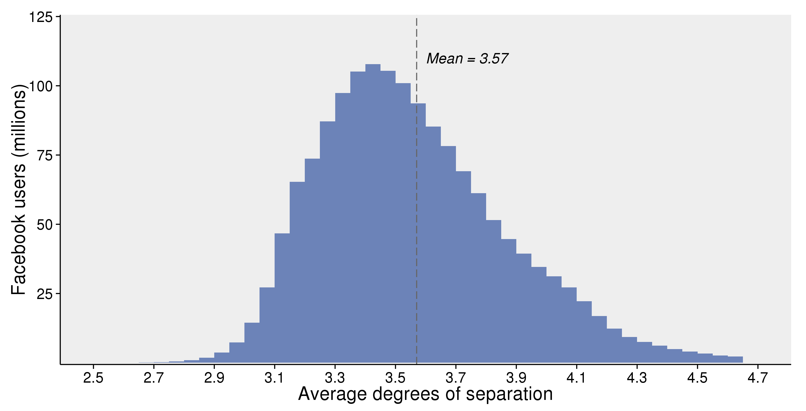
DIGRESSION - GRAPH ANALYSIS - FACEBOOK
How connected is the world?
Each person in the world (at least among the 1.59 billion people active on Facebook) is connected to every other person by an average of three and a half other people.
Rather than calculate it exactly, they estimate distances with statistical algorithms

Slide 26

DATA SCIENCE PART TIME COURSE
BIG DATA WITH…

Slide 27
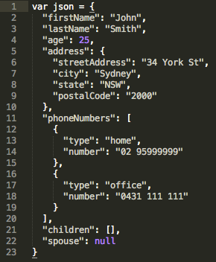
JSON - WHAT IS IT?
JSON - JavaScript Object Notation
Human readable data with attribute-value pairs.
What is inside the curly brackets is an object
In the object we declare variables with ‘attribute’ : ‘value’ pairs

Slide 28
JSON - HOW DOES IT RELATE TO DATA SCIENCE?
Webservices provide application programming interfaces (APIs) are now usually transferring data via JSON
Underlying document databases like MongoDB
Increasingly common data format

Slide 29

DATA SCIENCE PART TIME COURSE

Slide 30
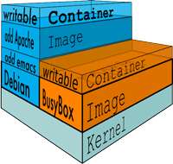
DOCKER - WHAT IS IT?
Docker containers wrap up a piece of software in a complete filesystem that contains everything it needs to run: code, runtime, system tools, system libraries – anything you can install on a server. This guarantees that it will always run the same, regardless of the environment it is running in.
Lightweight
Open
Secure

Slide 31

LAB = Homework! Follow the step by step guide: “Guide - Google Cloud Computing.ipynb”
DATA SCIENCE PART TIME COURSE

Slide 32
TEA BREAK
DATA SCIENCE PART TIME COURSE

Slide 33
PART 2
DATA SCIENCE PART TIME COURSE

Slide 34
Agenda
Questions
Communication & presentation skills
Group exercise
Networking & organisational politics
Consulting
Group exercise
Management
Group exercise
Governance: Data & analytics
Job seeking

Slide 35
By the end of this lesson you should be able to ...
Discuss the importance of effective communication in data science
Outline the requirements of a successful presentation
Appreciate the complexity and importance of organisational politics
Describe techniques for effective consulting
Explain the role of governance in data and analytics
Approach the job market with a more focused strategy

Slide 36
“
Tact is the ability to tell someone to go to hell in such a way that they look forward to the trip.
Winston S. Churchill

Slide 37

Communication

Slide 38
Communication Tips - Verbal business conversations:
know your audience
know the business
know the ‘why’
be clear and concise
over-communication is better than under-communication
listen carefully
ask questions in depth
break bread
be genuine (but not too familiar)

Slide 39
Communication Tips – Written business conversations:
make the purpose clear
stick to the topic
if it’s a proposal, explain why there is no easy alternative (e.g. Excel)
check spelling
use the language of the business unit
consider who should be cc’d
consider what would happen if your document were forwarded to other people in the organisation?
comprehension / interpretation issues
potential for misuse
political fallout

Slide 40
Communication Tips – Tailor to your audience:
language and complexity should be appropriate to the audience
if you have a mixed audience, explain complex concepts in three stages
very general level
something your parents would understand
slightly technical, more business-focused
something a business analyst would understand
more technical
something a peer would understand
all stages should communicate the key points in appropriate detail

Slide 41
Presentation

Slide 42
Presentation
What are presentations for?
Advice on how to prepare / deliver effective presentations?

Slide 43
Presentation
how you present your work will determine whether it gets implemented
if your work isn’t implemented it’s worthless
a data science presentation is not organised like a scientific presentation
1st: Business problem statement
2nd: Results
3rd: Recommended action
4th: Details
how you to got the results
appropriate to audience comprehension
considerations
can your audience understand and appreciate what’s in front of them?
what questions should you prepare for?
could there be a surprise expert in the audience?

Slide 44
Presentation
use graphics to punctuate your findings
keep charts simple
highlight the features you consider important
suppress the features that are distracting
but, don’t compromise visual integrity
don’t try to say too much on a single slide; build a story
don’t save the best for the last
they’ll be bored / disengaged by then
grab their attention!
the most important people are the busiest, so use their time carefully
shows your respect for being given this opportunity
shows them you know what’s important

Slide 45
Presentation
present your recommendations
be concise and confident
execs want to be able to make a decision soon
give them what they need
multiple options are even better than go/no-go
rehearse answers to the following:
what are our competitors doing?
what you would do (and why)?
what if you’re wrong?
they don’t want to hear, “we need to do further study”
may come out if the discussion goes deep enough, anyway
don’t offer it unless you get pinned on something you can’t answer

Slide 46

Group Exercise: Data Science in Business
Part 1: Pitch Your Project

Slide 47
Pitch your project
Prepare a 2-minute pitch for your project
Include:
background (the problem you want to solve)
assume the audience is familiar with the issues at some level
strategy (what you will use to solve it and what resources it will consume)
don’t get too technical
value proposition (what the Business will get for its investment)
make this compelling but don’t over-promise
Pretend you have been given the chance to propose your project to the executives; present it to the class.
10 minutes to prepare; 2 minutes per pitch

Slide 48
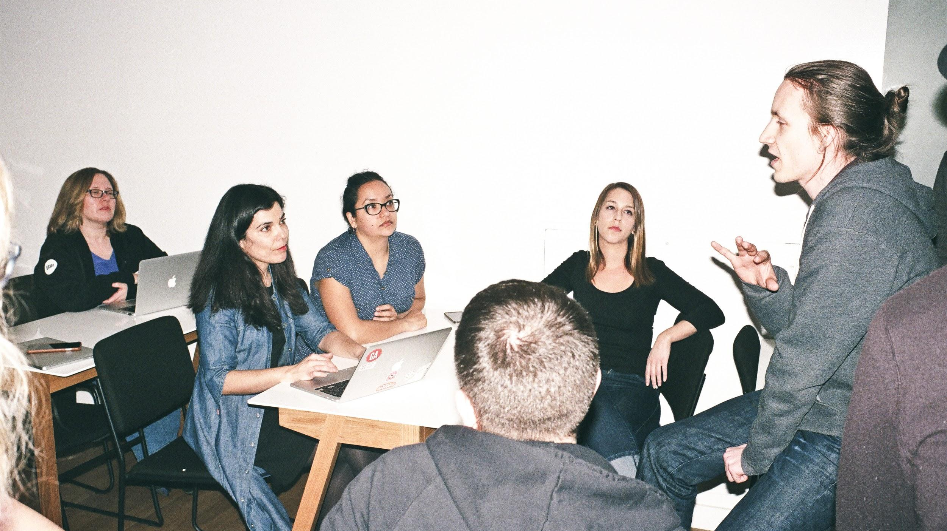
How did we go?

Slide 49
Politics

Slide 50
Networking
Why network?

Slide 51

Networking
external
keep on top of your game
meet like-minded people
discover interesting topics & techniques
assist in finding new roles
internal
who's good at what
who shares your vision
who should you have on your side
who should you watch out for
who is supporting whom
who is influencing whom

Slide 52
Organisational Politics
“While most people are wary of organisational politics, politically savvy leaders know how to manage them. They take initiative, and they forge consensus. Ultimately, the help others maximise their impact, so the organisation can continue to thrive in a highly competitive future.”
Political Savvy, Joel R DeLucca EBG Publications, 1999

Slide 53
Organisational Politics
Thoughts?
Impressions?
Where do you think we might be going with this?

Slide 54
Organisational Politics
Acceptance of a proposal depends on building support
understand the dynamics
vested interests
conflicts of interest
potential winners and losers
networks of influence and opinion
create winners
show how success will make your champions into heroes
if possible, deal with resistance by offering partnerships
if conflict is inevitable (or encouraged), build a strategic network to get round (or through) the blockers

Slide 55
Organisational Politics
Success of a project depends on maintaining support
a successful prototype doesn’t guarantee acceptance into production
expectations diverge
suspicions propagate
keep stakeholders on-side throughout project development
plan to deal with blockers
dead wood
status quo
professional envy; competition for funding, status
fear of loss of control or relevance
prepare end-users for roll-out
exploit occupational change management resources if available
never stop selling -- even after project delivery

Slide 56
Consulting

Slide 57
Internal and External Consulting
What do these have in common?
How do they differ?

Slide 58
Internal and External Consulting
Internal Consulting
position is more secure; failure is usually tolerable
there is time to develop trust, business acumen, and expert networks
reputations and politics are more visible
you can negotiate for support and exploit existing alliances
External Consulting
failure is usually terminal
you’re on your own
you need to convince everybody that they can trust your advice
your presence will probably engender some hostility and/or anxiety

Slide 59
Stakeholder Cues
Identifying resistance
“I just don’t see the point…”
“I still don’t understand what you’re hoping to achieve…”
they are saying they will not be convinced
these are confirmed blockers
Eliciting candour
ask 3 times what they concerns/issues are
think about each answer, then ask a follow-up question with more depth
the 1st answer will be high-level, vague
the 2nd answer will be somewhat indulgent, slightly defensive, and probing
the 3rd answer will take you into confidence

Slide 60
Group Exercise: Data Science in Business
Part 2: Networking & Negotiation

Slide 61
Negotiation Task
Form 2 groups.
Take turns in the hot seat:
defend your project, try to win support
others: adopt roles of supporter or resistor
assume a particular role within the enterprise (on par with the presenter)
supporters offer helpful criticism or suggest collaborative angles
resistors question the value proposition and try to discourage the proposal
Make notes
specifics of criticisms
create a map of the organisational politics for the project
you can assume the existence of other people in the organisation (e.g. the decision makers) if you want to make a more realistic map
4 minutes for each presenter

Slide 62
What did we learn?

Slide 63
Governance

Slide 64
Management
Managing Your Client
keep the contract simple
but make sure it reflects your understanding of the problem unambiguously
keep the scope of any deliverables tightly defined
it may be better to negotiate, contract, deliver in cycles
don't do any work not agreed to
don’t deliver too little or too much
don't encourage trite conclusions
your notice period should be the same as their notice period
read / learn as much as you can
about contracting in general
about the client’s business

Slide 65
Management
Managing Your Team
management is hard
most people leave their manager, not their job
you don’t have to do all the thinking; make sure to keep them challenged
clever people won’t tolerate micromanagement
let people do what they are good at
and let them try out their ideas, even if these aren’t what you would try first
keep analysts on a leash
data scientists like to go down rabbit holes
sometimes it will be rewarding to chase long shots, but don't lose sight of ROI
maintain the focus
recognise contributions, share credit

Slide 66
Management
Managing Your Manager
understand their limitations
many business team managers do not understand statistics or programming
many data science managers have never worked as an analyst
many accomplished analysts don’t understand how to win or manage clients
not everyone can manage teams, even if they do understand the work
they may be subject to decision pressure
avoid contradiction
present alternative perspectives or options
be diplomatic and impartial in presenting your findings and recommendations
beware of invitations to extrapolate
guide them tactfully toward optimal, informed decisions

Slide 67
Management
Any other advice?

Slide 68
Job Seeking

Slide 69




Aspiring Data Scientist Target Industry: anything cool Target Salary: $200,000+ $100,000
Worked at:

Slide 70
Job Applications
the Job Description is often a wish list
could be prepared by somebody who doesn’t understand the work
call recruiter, open a dialog, get the inside scoop
you should meet ≥ 80% of key requirements of the role
recruiters usually treat blind selection of candidates as a specification-matching exercise
the client is hiring a person, not a specification, but they often don't know what kind of person they need
business experience can be more important than technical experience
hiring decisions are usually made by someone with more of a business orientation than a technical one: they are hiring to solve a business problem!
emphasise your experience in related industry verticals

Slide 71
Job Applications
Résumé
3 pages max (as much white space as possible)
skills, education, current/recent employment on 1st page
highlights of projects, not responsibilities
PAR (Problem addressed, Approach/Action taken, Results/Recommendations)
cover letter
2 pages max
many won’t read it unless the résumé already caught their attention, but some will read it first
demonstrate how your experience and knowledge would fit role and explain why you want to work for this employer
not every candidate will bother to provide one; an opportunity for you to stand out

Slide 72
Job Applications
Follow up
call the recruiter or advertiser; most people don’t, so here is a chance to ensure that your résumé gets read
ask when they expect to know something
follow up regularly
Interview
research the employer
research the interviewers
prepare for their questions
practice your answers
prepare your own questions
read advice about interview preparation for your profession
data scientists and analysts
the employer’s industry

Slide 73
Job Applications
Any more advice?

Slide 74
INTERVIEWS
DATA SCIENCE PART TIME COURSE

Slide 75

SKiLLz
Problem solving
Coding ability
Communication

Slide 76

Knowledge
Technical knowledge
Machine Learning
Tools (software)
Certifications
Business Knowledge
how the world works
Statistics
Data Handling

Slide 77

Personal Traits
Interest in Technology
Interest in data and what it represents
Good Communicator
Networking
Willing to share ideas

Slide 78
INTERVIEWS - TYPICAL TECHNICAL QUESTIONS
What is R² (for linear regression)
How do you assess whether to include a variable in a linear regression model?
How would you assess model accuracy?
Explain what regularisation is and why it is useful.
Explain what resampling methods are and why they are useful. Also explain their limitations.
Give an example of how you would use experimental design to answer a question about user behaviour.

Slide 79
INTERVIEWS - HILARY MASON’S QUESTIONS
1. What was the last thing that you made for fun?
2. What's your favourite algorithm? Can you explain it to me?
3. Tell me about a data project you've done that was successful. How did you add unique value?
4. Tell me about something that failed. What would you change if you had to do it over again? ...
5. You clearly know a bit about our data and our work. When you look around, what's the first thing that comes to mind as "why haven't you done X"?! ...

Slide 80
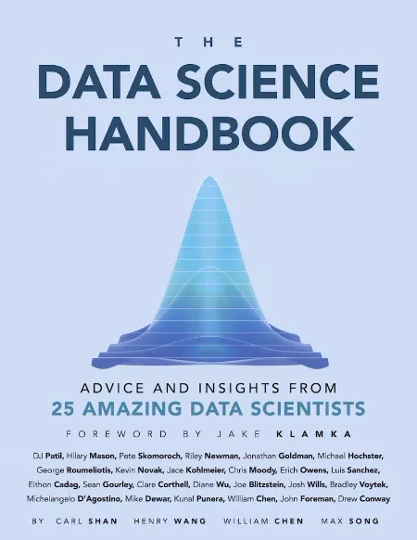
INTERVIEWS

Slide 81
Professional Development
You can’t stand still in business. In data science, it isn’t even enough to keep a steady pace.
join meetups
attend webinars (use discretion)
learn and apply new techniques
learn about novel applications
follow industry trends
pick one or two specialities to develop
conduct projects, share results
blog, present

